Slide 1

Car Number Plate Detection
Using Image Processing Techniques

Slide 2





Meet our team
Md. Raihan Sharker
Md. Saif Uddin bhuiyan
Md. Shakibul Alam
Synthia Rahman SHithi
Id: 2125051073
Id: 2125051083
Id: 2125051093
Id: 2125051017

Slide 3

Agenda
Introduction
Objective
Key features
Code Explanation
Outcome
Future Scope

Slide 4
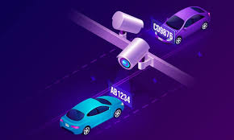
Introduction
This project involves detecting car number plates from images using image processing techniques. It includes noise removal, edge detection, and ROI extraction to identify number plate regions.

Slide 5

Objective
*Accurately detect and
process car number plates.
*Remove noise using optimized filters.
*Identify Region of Interest (ROI)
for number plate.

Slide 6
Key Features
Image input and grayscale conversion.
Horizontal and Vertical Edge Detection.
Noise Removal (Dilate and Erode).
Dynamic Threshold for filtering.
ROI Extraction.

Slide 7
Code Explanation
Image Preprocessing:
Edge Detection:
ROI Extraction:
Load and process input image.
Remove noise using Dilate and Erode.
Plot Horizontal and Vertical Histograms.
Apply Dynamic Threshold.
Identifying Potential Number Plate Regions.
Display the cropped image containing only the number plate

Slide 8

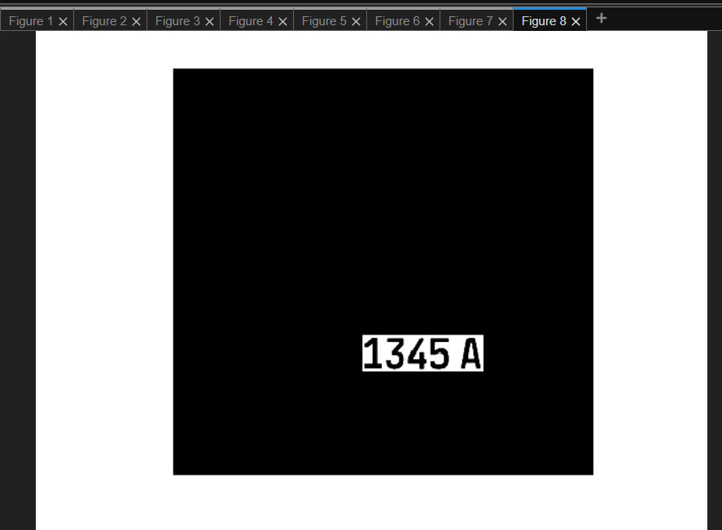
Outcome

Slide 9

Future Scope
*Implement multiple plate detection.
*Integrate machine learning for higher accuracy.
*Enhance speed and robustness for real-time applications.

Slide 10

Conclusion
While the presented method offers a solid foundation for number plate detection, further refinement and optimization are essential to enhance its accuracy and robustness in real-world scenarios. Future research directions may include exploring advanced deep learning techniques, such as convolutional neural networks (CNNs), to improve the system's ability to handle complex image variations and challenging lighting conditions.

Slide 11

Ask Any Questions?

Slide 12
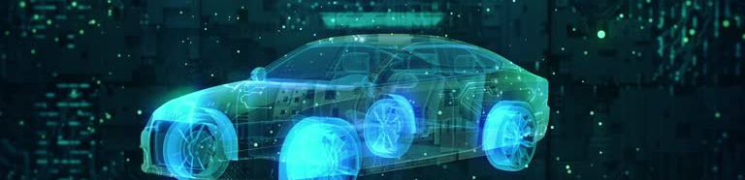
Thank you

